Slide 1
Tutorial 6
Statistical Computation and Analysis
Spring 2026

Slide 2
Tutorial Outline
Short revision: Type I & II errors and z-test
Continuous data
Normal models
Bayesian p-values
Paired data
Unpaired data
Shared versus separate sigma in Bayesian models
Student-t distribution & Robust models
Frequentist t-tests

Slide 3
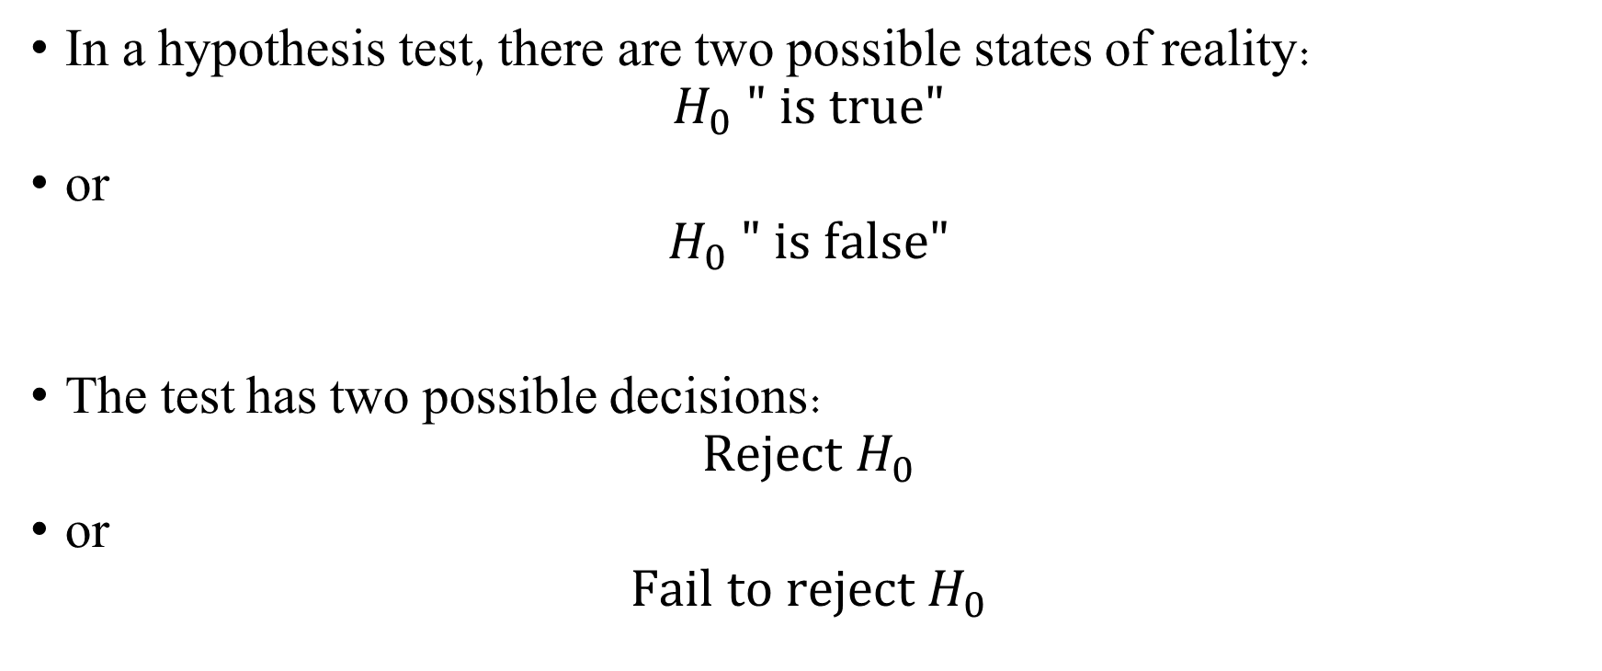
Type I and Type II Errors
In a hypothesis test, there are two possible states of reality:
$$H_{0} " is true"$$
or
$$H_{0} " is false"$$
The test has two possible decisions:
$$\text{Reject} H_{0}$$
or
$$\text{Fail} \text{to} \text{reject} H_{0}$$

Slide 4
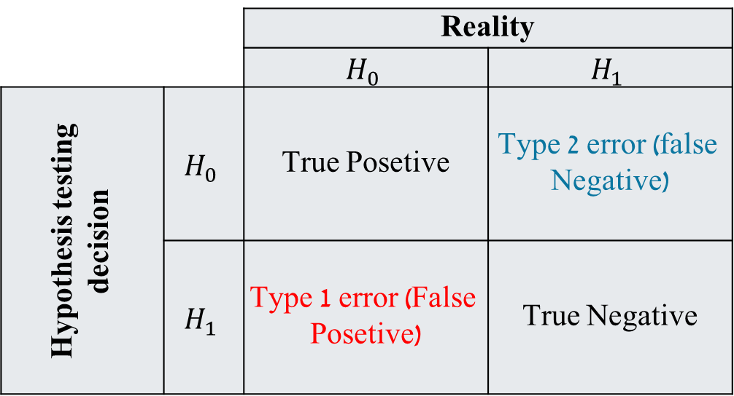
Type I and Type II Errors
Type I error - rejecting the null hypothesis when the null hypothesis is true.
Type II error - failing to reject a false null model
Reality
$$H_{1}$$ | $$H_{0}$$
Type 2 error (false Negative) | True Posetive | $$H_{0}$$ | Hypothesis testing decision
True Negative | Type 1 error (False Posetive) | $$H_{1}$$
Notes:
בעברית – טעות מסוג 1 אומרת שדחינו את היפותזת האפס למרות שהיא מה שמתקיים במציאות.
טעות מסוג 2 אומרת שלא הצלחנו לדחות את השערת האפס למרות שהיא לא מה שמתקיים במציאות.

Slide 5

Significance Level and p-value
The decision uses a significance threshold $α.$
It defines the long-run Type I error rate allowed by the test decision rule.
Usually:
$$α=0.05$$

Slide 6
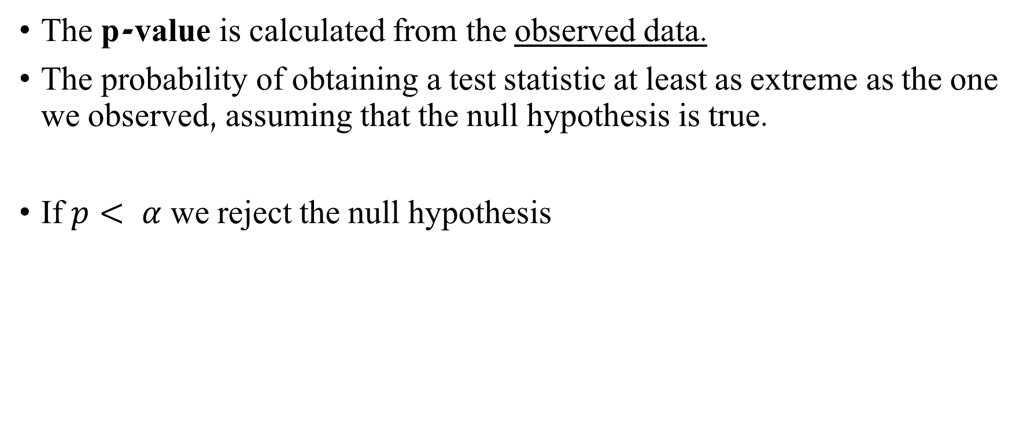
Significance Level and p-value
The p-value is calculated from the observed data.
The probability of obtaining a test statistic at least as extreme as the one we observed, assuming that the null hypothesis is true.
If $p< α$ we reject the null hypothesis ​
Notes:
Important: $p≠P(H_{0} is true)$
הערך הזה מחשב את "ההסתברות לקבל את הסטטיסטי קיצוני לפחות כמו מה שקיבלנו בהנחה שהיפותזת האפס היא הנכונה" אם הערך קטן מרמת המובהקות שקבענו-אלפא אז אנחנו נדחה את היפותזת האפס, זה לא סביר לקבל את הערך שחושב מהנתונים אם היפותזת האפס נכונה ולכן אנחנו דוחים אותה.

Slide 7
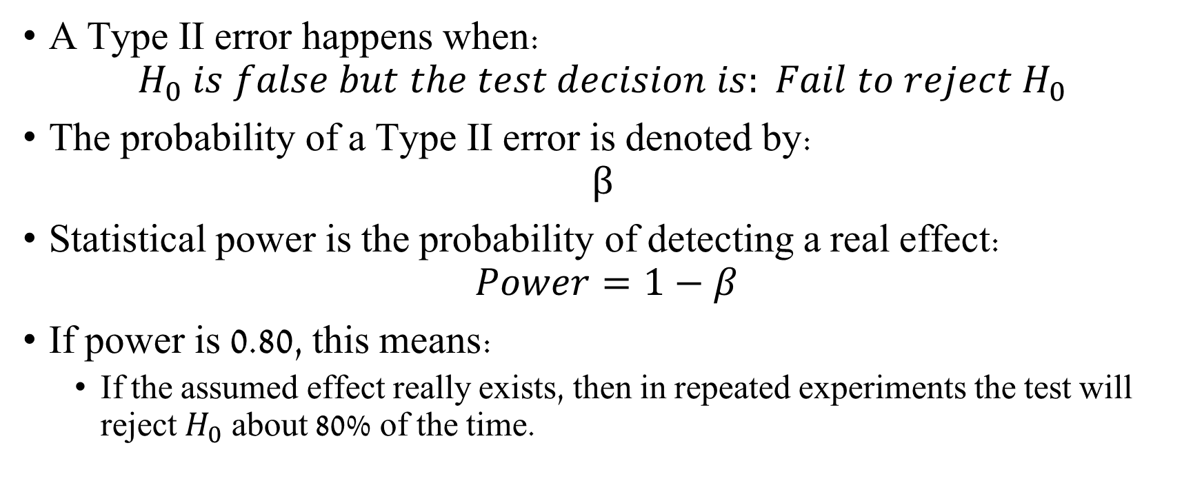
Power and Type II error
A Type II error happens when:
$$H_{0} is false but the test decision is: Fail to reject H_{0} ​$$
The probability of a Type II error is denoted by:
$$β$$
Statistical power is the probability of detecting a real effect:
$$Power=1−β$$
If power is 0.80, this means:
If the assumed effect really exists, then in repeated experiments the test will reject $H_{0}$ about 80% of the time.
Notes:
טעות מסוג 2 קוראת כשהיפותזת האפס לא נכונה במציאות אבל לא הצלחנו לדחות אותה.
עוצמה סטטיסטית היא ההסתברות לזהות אפקט אמיתי והיא מסומנת ע"י אחד פחות בטא. אם העוצמה היא 0.8- אם האפקט שנמצא באמת מתקיים במציאות אז בניסויים חוזרים, נצליח לדחות את השערת האפס בערך 80% מהזמן.

Slide 8
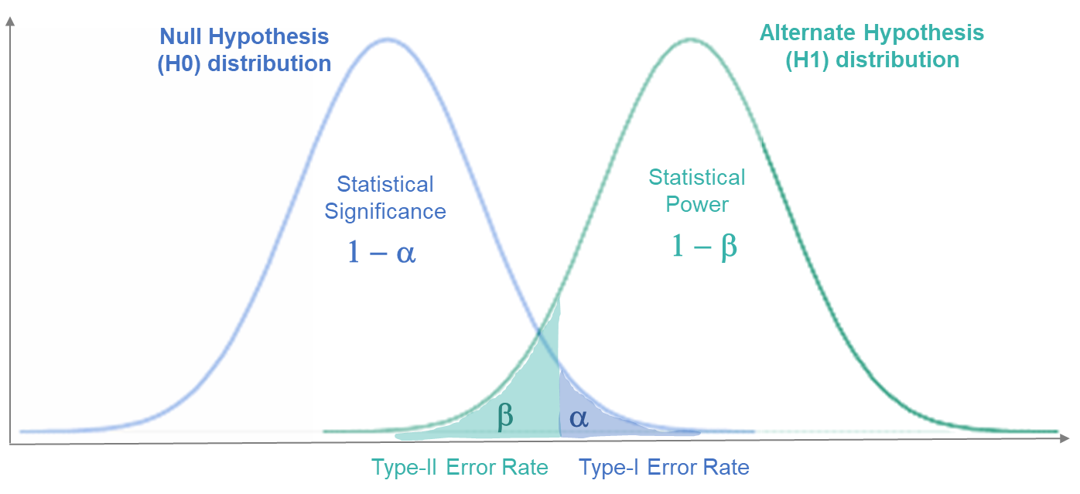

Power and Type II error
Power increases when:
the effect size is larger
the sample size is larger
the noise / variance is smaller
α is larger
Connection:
$α$ → Type I error
$β$ → Type II error
1−β → Power

Slide 9
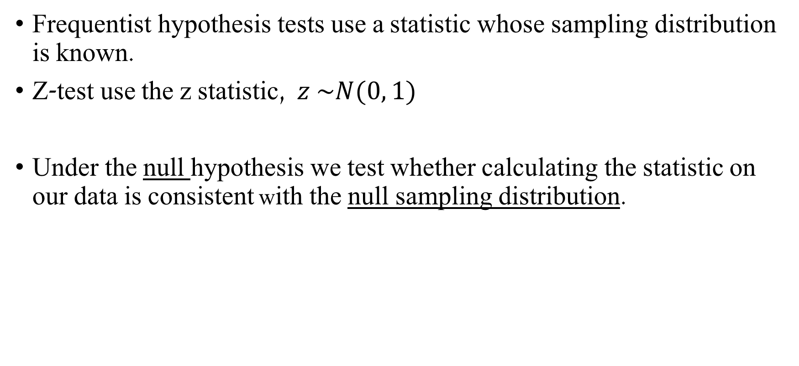
Frequentist Two-proportion Z-test
Frequentist hypothesis tests use a statistic whose sampling distribution is known.
Z-test use the z statistic, $z \sim N(0, 1)$
Under the null hypothesis we test whether calculating the statistic on our data is consistent with the null sampling distribution.
Notes:
אנחנו מניחים שהשערת האפס נכונה, בונים התפלגות דגימה של הסטטיסטי z תחת השערת האפס, ואז בודקים איפה הסטטיסטי הנצפה נמצא ביחס להתפלגות הזו.

Slide 10
Frequentist Two-proportion Z-test
Assumptions
Random sampling
Independent groups
Large sample size The test relies on a normal approximation. If the sample is too small, the approximation may be unreliable.
​If the assumptions are not met, use a different test or interpret the result cautiously.
Notes:
בדרך כלל משתמשים במבחן z כאשר:
יש לנו מדגם גדול מספיק.
התפלגות הדגימה של האומד בקירוב נורמלית.
סטיית התקן של התפלגות הדגימה ידועה או ניתנת להערכה טובה.
במבחני פרופורציות, משתמשים בקירוב נורמלי להתפלגות הבינומית.

Slide 11

Frequentist Two-proportion z-Test
Null hypothesis is:
$$H_{0}:θ_{A}=θ_{B}$$
The two-sided alternative is:
$$H_{1}:θ_{A}≠θ_{B}$$

Slide 12

Z Statistic
$$z=\frac{\text{observed} \text{estimate}−\text{null} \text{value}}{\text{standard} \text{error}}$$
$$z=\frac{\hat{θ}−θ_{0}}{SE}$$
Notes:
“Pooled” means that under the null hypothesis, we combine the two groups and estimate one shared probability for both groups.
This shared probability is then used to calculate the standard error of the difference under H0​.
הרעיון הכללי של סטטיסטי z הוא:
$$z=\frac{\text{observed} \text{estimate}−\text{null} \text{value}}{\text{standard} \text{error}}$$
כלומר:
$$z=\frac{\hat{θ}−θ_{0}}{SE}$$
או עבור הבדל בין שתי פרופורציות:
$$z=\frac{\left({\hat{θ}}_{A}−{\hat{θ}}_{B}\right)−0}{SE_{{\hat{θ}}_{A}−{\hat{θ}}_{B}}}$$
כאשר $SE$הוא השגיאה התקנית של האומד

Slide 13

Z Statistic - Two-proportion
$$z=\frac{{\hat{θ}}_{A}−{\hat{θ}}_{B}}{\sqrt{{\hat{θ}}_{pooled}\left(1−{\hat{θ}}_{pooled}\right)\left(\frac{1}{n_{A}}+\frac{1}{n_{B}}\right)}}$$
Where:
$${\hat{θ}}_{pooled}=\frac{z_{A}+z_{B}}{n_{A}+n_{B}}$$
Notes:
“Pooled” means that under the null hypothesis, we combine the two groups and estimate one shared probability for both groups.
This shared probability is then used to calculate the standard error of the difference under H0​.
הרעיון הכללי של סטטיסטי z הוא:
$$z=\frac{\text{observed} \text{estimate}−\text{null} \text{value}}{\text{standard} \text{error}}$$
כלומר:
$$z=\frac{\hat{θ}−θ_{0}}{SE}$$
או עבור הבדל בין שתי פרופורציות:
$$z=\frac{\left({\hat{θ}}_{A}−{\hat{θ}}_{B}\right)−0}{SE_{{\hat{θ}}_{A}−{\hat{θ}}_{B}}}$$
כאשר $SE$הוא השגיאה התקנית של האומד

Slide 14
Z Statistic - Interpretation
A z value tells us how many standard errors the observed estimate is away from the null value.
For example:
𝑧=2
Means that the observed estimate is two standard errors above what we would expect under the null model.
𝑧=−2
Means that the observed estimate is two standard errors below the null value.

Slide 15
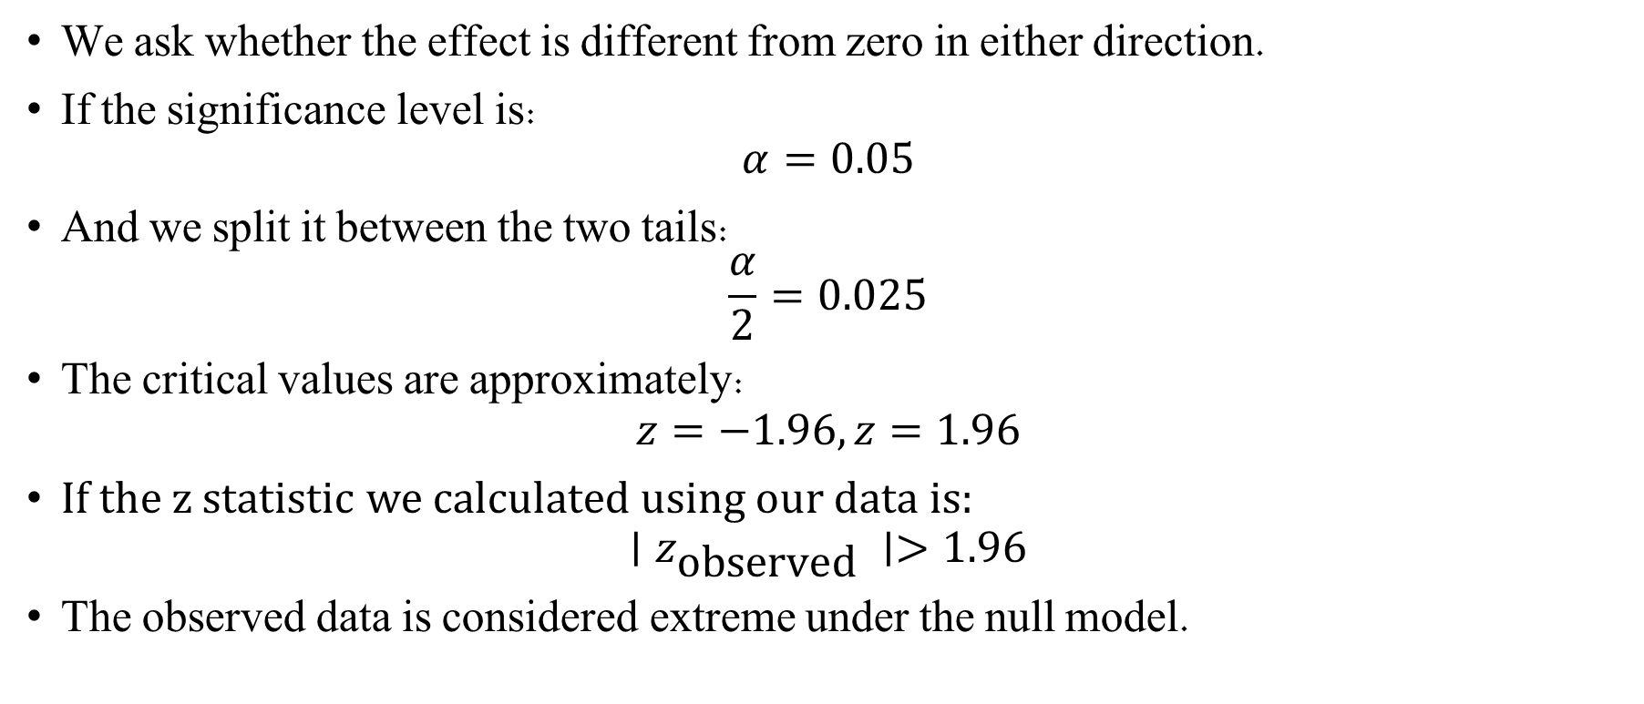
Two-tailed z-test
We ask whether the effect is different from zero in either direction.
If the significance level is:
$$α=0.05$$
And we split it between the two tails:
$$\frac{α}{2}=0.025$$
The critical values are approximately:
$$z=−1.96, z=1.96$$
$If$ the z statistic we calculated using our data is:
$$∣z_{\text{observed}} ∣>1.96$$
The observed data is considered extreme under the null model.
Notes:
𝛼 controls the long-run Type I error rate of the decision rule.
The 𝑧-value is not enough by itself to reject the null . hypothesis We need the null distribution and the significance level.
Illustration credit - https://analystprep.com/cfa-level-1-exam/quantitative-methods/one-tailed-vs-two-tailed-hypothesis-testing/

Slide 16
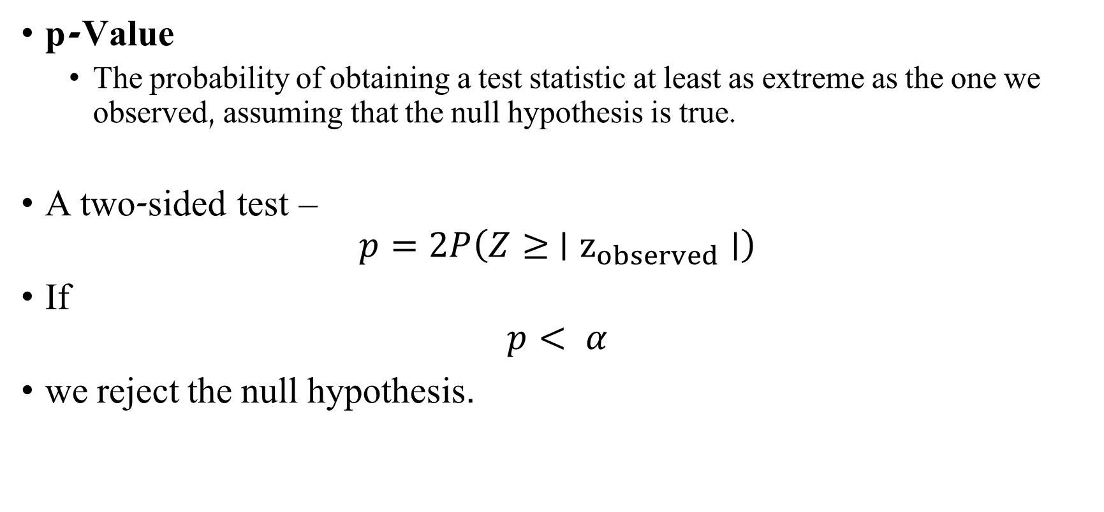
Two-sided p-Value
p-Value
The probability of obtaining a test statistic at least as extreme as the one we observed, assuming that the null hypothesis is true.
A two-sided test –
$$p=2P\left(Z≥ ∣z_{observed}∣\right)$$
If
$$p< α$$
we reject the null hypothesis.
Notes:
The p-value is not the probability that $H_{0}$is true!

Slide 17
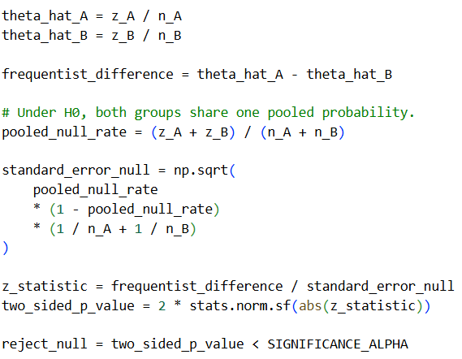
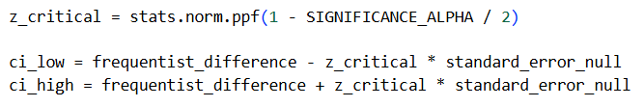
z-Test
Calculating the thetas
Calculating the pooled theta and the std under the null model
Calculating the z statistic, p-value and z critical value
Calculating the confidence interval

Slide 18
z-Test

Slide 19
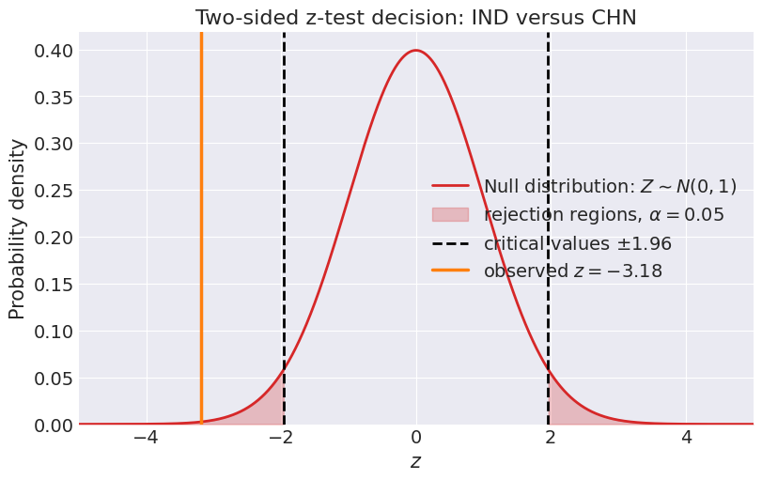
z-Test

Slide 20
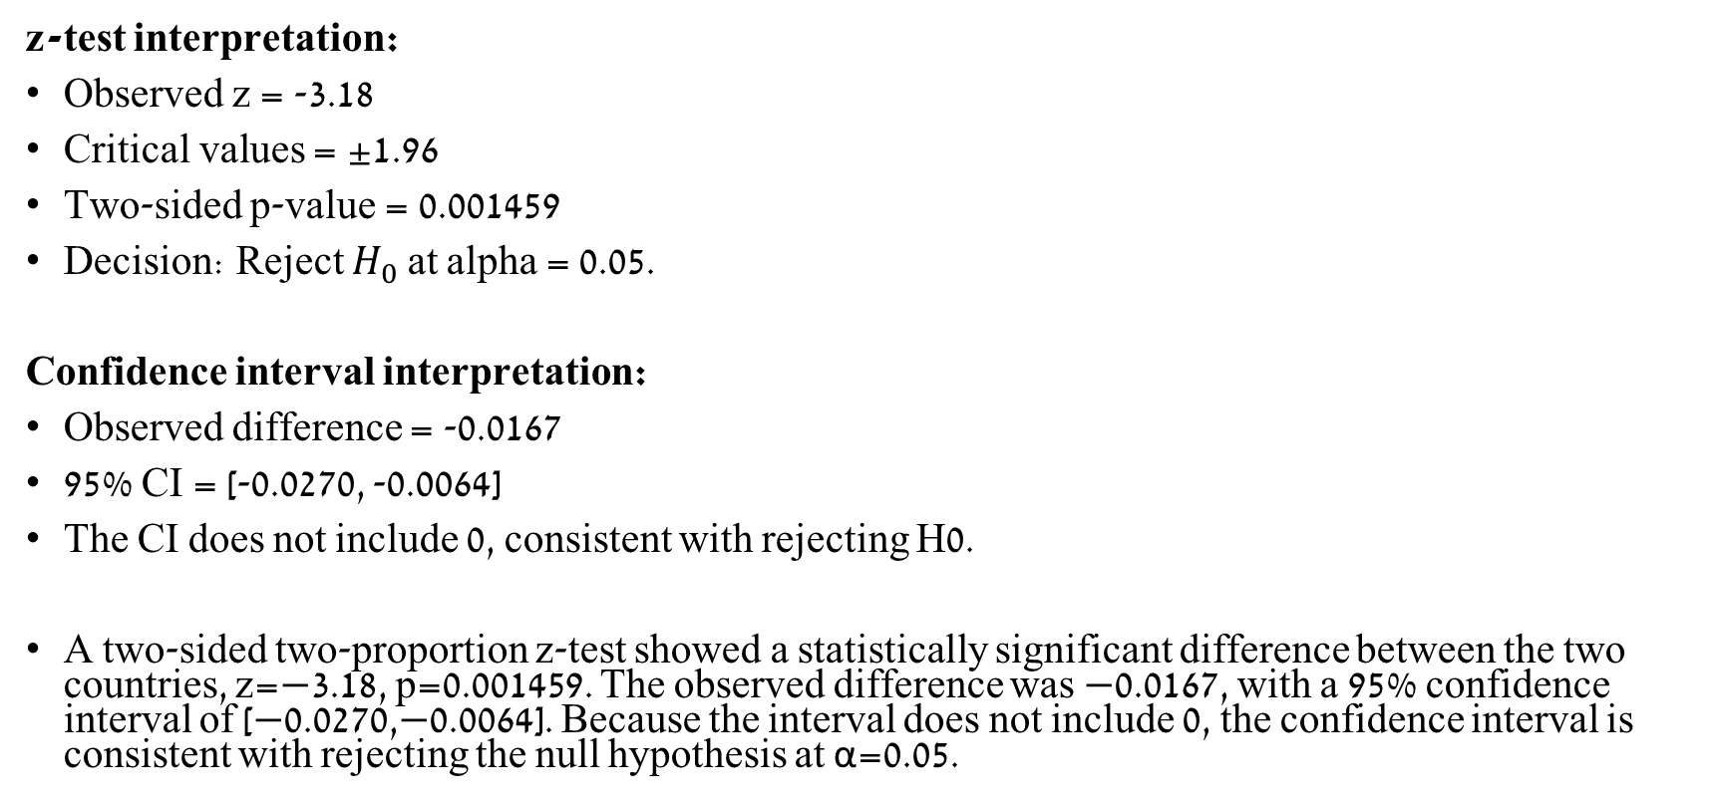
Statistical reporting
z-test interpretation:
Observed z = -3.18
Critical values = ±1.96
Two-sided p-value = 0.001459
Decision: Reject $H_{0}$at alpha = 0.05.
Confidence interval interpretation:
Observed difference = -0.0167
95% CI = [-0.0270, -0.0064]
The CI does not include 0, consistent with rejecting H0.
A two-sided two-proportion z-test showed a statistically significant difference between the two countries, z=−3.18, p=0.001459. The observed difference was −0.0167, with a 95% confidence interval of [−0.0270,−0.0064]. Because the interval does not include 0, the confidence interval is consistent with rejecting the null hypothesis at α=0.05.

Slide 21
Normal Models

Slide 22
Continuous data
Continuous measurements have units
Require a continuous likelihood
Examples:
Weight, measured in kg
Height, measured in cm
Reaction time, measured in milliseconds
Blood pressure, measured in mmHg

Slide 23
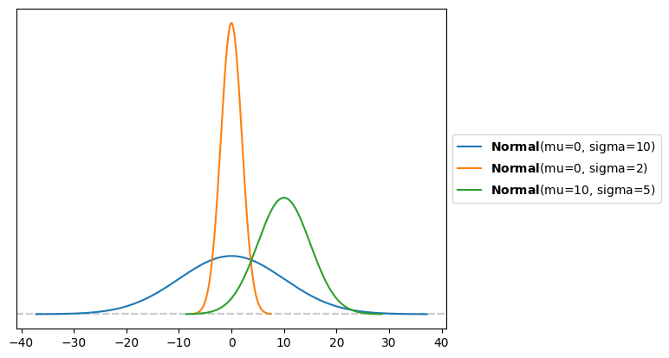
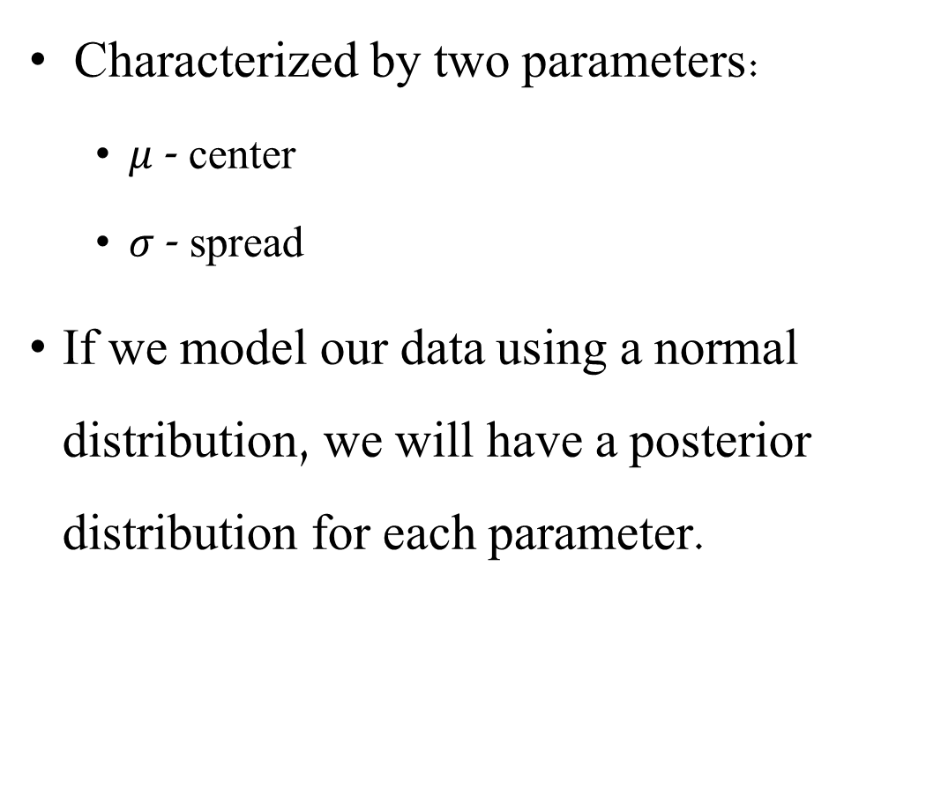
Normal Distribution
Characterized by two parameters:
$μ$ - center
$σ$ - spread
If we model our data using a normal distribution, we will have a posterior distribution for each parameter.

Slide 24
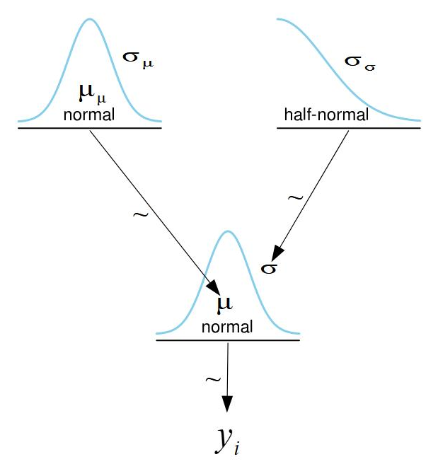

Normal Distribution
Each parameter needs its own prior
Two priors
We will use a normal prior for $μ$
And a half normal prior for $σ$
Cannot be negative

Slide 25
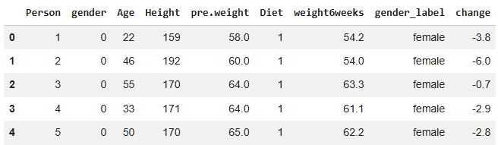
Normal Distribution Bayesian Model
The generated dataset contains measurements from the same people before and after six weeks of dieting:
pre.weight: weight in kg before the diet
weight6weeks: weight in kg after six weeks

Slide 26
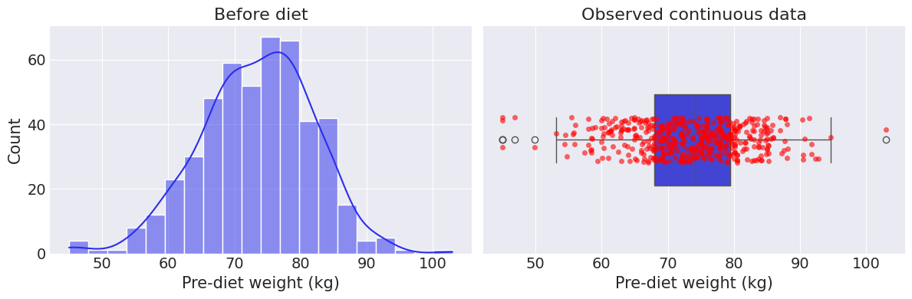
Normal Distribution Bayesian Model
Let’s model the pre-diet weight data
Notes:
Box plot –
Line inside the box: median
The box: quartiles (25th and 75th percentiles)
Whiskers: Range excluding outliers
Dots: outliers (usually more than 1.5 IQR beyond IQR)

Slide 27
Normal Distribution Bayesian Model
Box plot –
Line inside the box: median
The box: quartiles (25th and 75th percentiles)
Whiskers: Range excluding outliers
Dots: outliers (usually more than 1.5 IQR beyond IQR)
Notes:
Box plot –
Line inside the box: median
The box: quartiles (25th and 75th percentiles)
Whiskers: Range excluding outliers
Dots: outliers (usually more than 1.5 IQR beyond IQR)

Slide 28
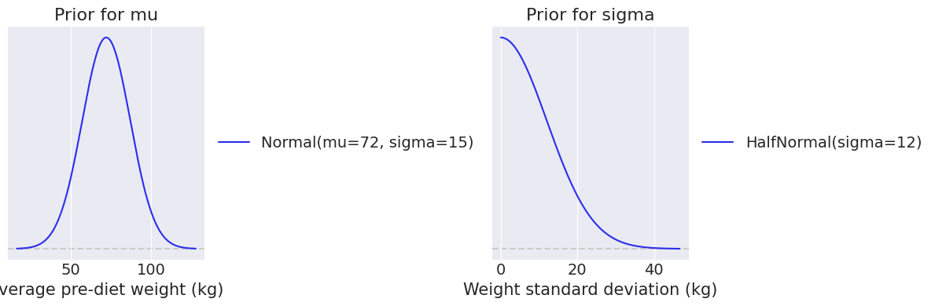

Normal Distribution Bayesian Model
Choosing priors
Weight is measured in kilograms.
Therefore, our priors will be chosen in kilograms
$$y \sim Normal\left(μ, σ\right)$$
$$μ \sim Normal\left(72, 15\right)$$
$$σ \sim HalfNormal(12)$$
Notes:
Priors in real data units
Priors for 𝜇 and 𝜎 must be chosen in the units of the data.
For reaction time:
$$μ∼\text{Normal} (270,50)$$
means expected reaction time is around 270 ms, with uncertainty in ms.
$$σ∼\text{HalfNormal} (75)$$
means expected between-subject spread is positive and measured in ms.

Slide 29
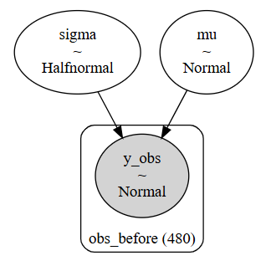
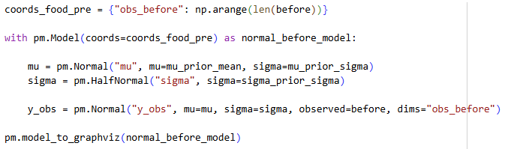
Normal Distribution Bayesian Model
Model
Notes:
Priors in real data units
Priors for 𝜇 and 𝜎 must be chosen in the units of the data.

Slide 30
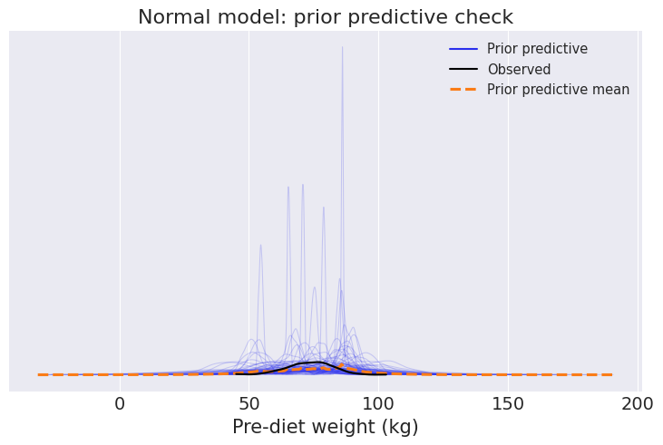
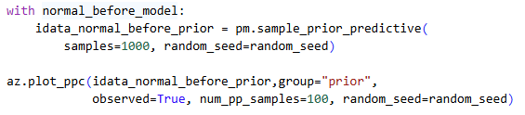
Normal Distribution Bayesian Model
Prior predictive check

Slide 31
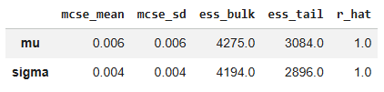
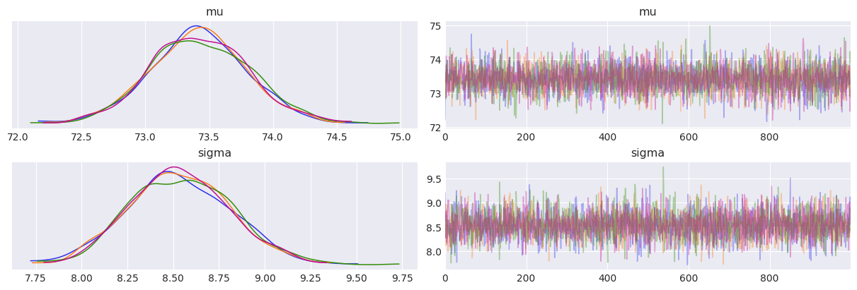
Normal Distribution Bayesian Model
Sampling diagnostic
Summary diagnostics
Trace plots
Notes:
Trace plot: checks whether chains mix and overlap.
R-hat: should be close to 1.
ESS: effective sample size; should be large enough.
MCSE: Monte Carlo standard error; should be small relative to posterior uncertainty.
Divergences: indicate possible sampling/model geometry problems.

Slide 32
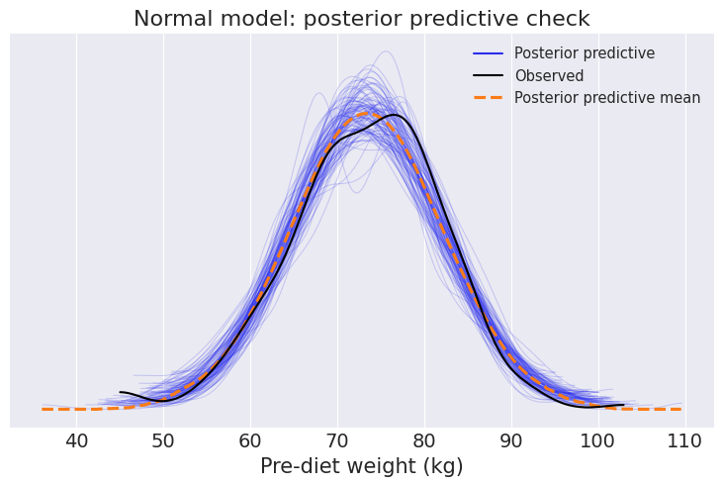
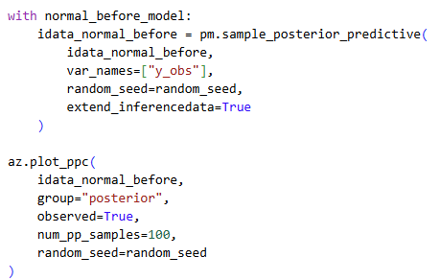
Normal Distribution Bayesian Model
Posterior predictive check
Notes:
shows that we’ve learned from our data

Slide 33

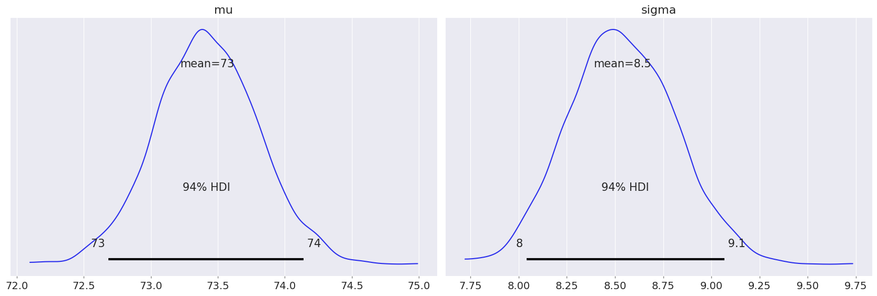
Normal Distribution Bayesian Model
Posterior

Slide 34
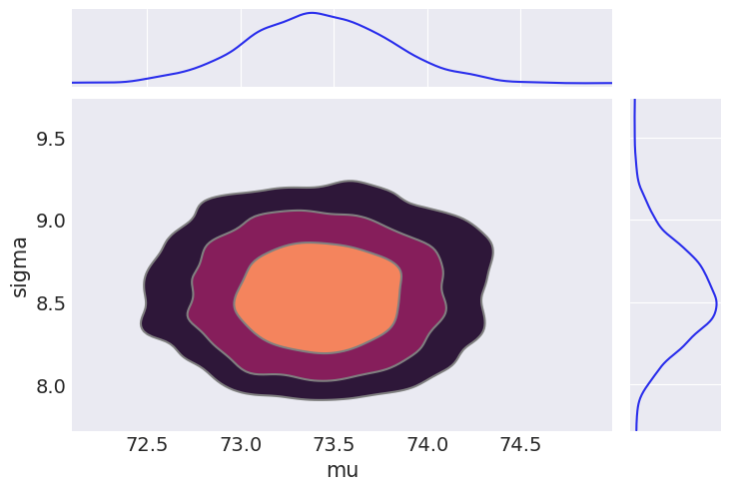
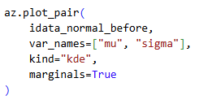
Normal Distribution Bayesian Model
Posterior
Pair plot
Notes:
Az.plot_pair() is a visualization function used to create pair plots that display the joint posterior draws for two or more parameters.
They were sampled jointly
Every sample has each a value for mu and one for sigma
Are they correlated?
Not really (one doesn’t grow or shrink with the other)
What we want to see:
Ideally, we want to see a cloud of dots without extreme, tight correlations and without any divergences.
If divergences do appear, plot_pair() helps us identify the specific "problematic regions" of the posterior parameter space where the sampling algorithm (like NUTS) struggled to explore properly

Slide 35
Bayesian p-value
Based on posterior predictive samples
For each posterior predictive dataset, we calculate the same statistic as in the observed data.
Then we compare the observed statistic to the posterior predictive sampling distribution.

Slide 36
Bayesian p-value
Similarity to frequentist p-values:
Both ask whether the observed data are extreme relative to a reference distribution.
Difference from frequentist p-values:
Frequentist p-values integrate the null sampling distribution.
Bayesian p-values integrate, or sum over, the posterior predictive sampling distribution.
Bayesian p-values are used as a measure of fit, not as a significance decision.

Slide 37
Normal Distribution Bayesian Model
How to interpret Bayesian p-values?
Values close to 0 or 1 may indicate that the model has difficulty reproducing that aspect of the observed data.
Values closer to the middle suggest that the observed statistic is not unusual under the fitted model.

Slide 38
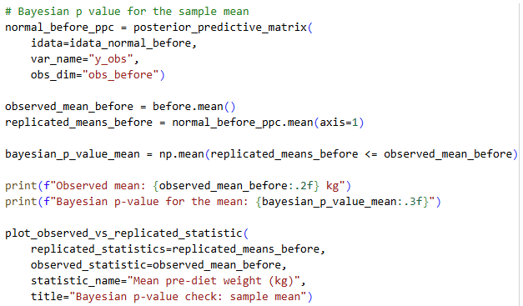
Normal Distribution Bayesian Model
Bayesian p-value – sample mean
Notes:
We first generate posterior predictive data
For each posterior predictive dataset, we calculate the same statistic as in the observed data.
Then we compare the observed statistic to the posterior predictive sampling distribution.
Similarity to frequentist p-values:
Both ask whether the observed data are extreme relative to a reference distribution.
Difference from frequentist p-values:
Frequentist p-values integrate the null sampling distribution.
Bayesian p-values integrate, or sum over, the posterior predictive sampling distribution.
Bayesian p-values are used as a measure of fit, not as a significance decision.

Slide 39
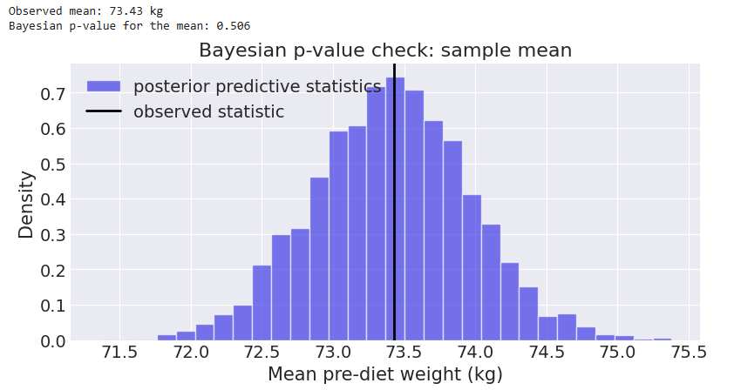
Normal Distribution Bayesian Model
Bayesian p-value – sample mean
Notes:
The observed mean and observed SD are close to the center of the posterior predictive statistic distributions. Therefore, the fitted Normal model can reproduce these aspects of the observed data reasonably well.

Slide 40
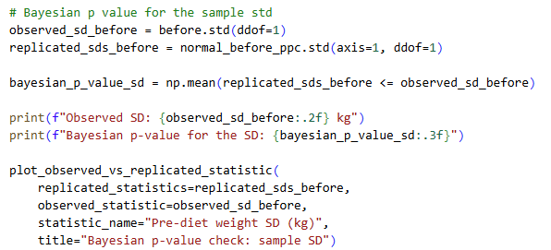
Normal Distribution Bayesian Model
Bayesian p-value -sample SD

Slide 41
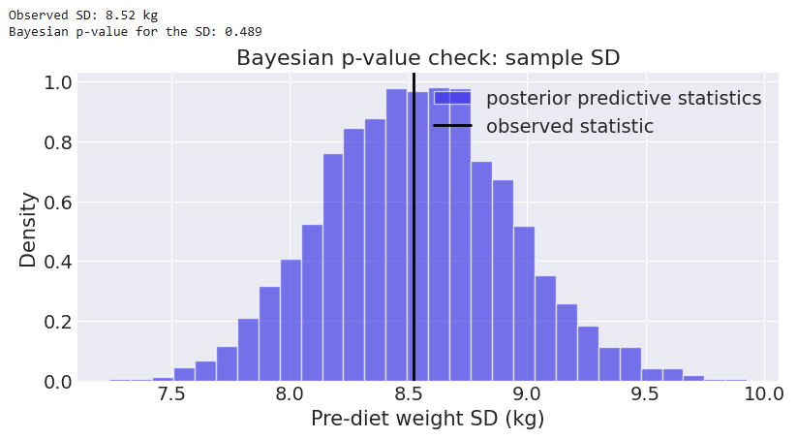
Normal Distribution Bayesian Model
Bayesian p-value - sample SD
Notes:
The observed mean and observed SD are close to the center of the posterior predictive statistic distributions. Therefore, the fitted Normal model can reproduce these aspects of the observed data reasonably well.

Slide 42
Paired vs. Unpaired Data

Slide 43
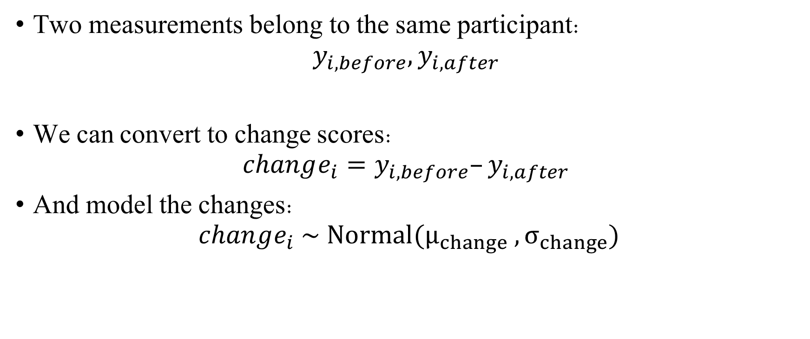
Paired Data
Two measurements belong to the same participant:
$$y_{i,before}, y_{i,after} ​$$
We can convert to change scores:
$$change_{i}=y_{i,before}–y_{i,after} ​$$
And model the changes:
$$change_{i} \sim Normal(μ_{change} ​,σ_{change}​)$$

Slide 44

Unpaired Data
Unpaired data
Different participants belong to different groups:
$$y_{i} ​∼Normal(μ_{group\left[i\right]} ​,σ)$$

Slide 45
Bayesian Paired Model & Hypothesis testing

Slide 46
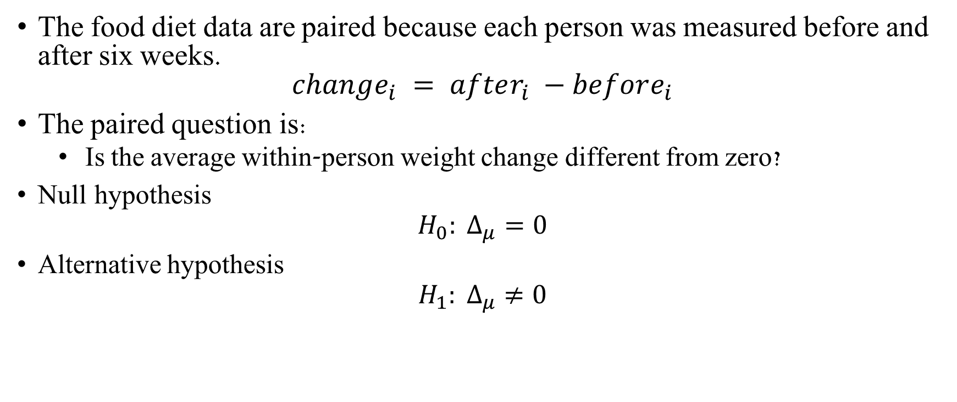
Bayesian Paired Model
The food diet data are paired because each person was measured before and after six weeks.
$$change_{i} = after_{i} −before_{i}$$
The paired question is:
Is the average within-person weight change different from zero?
Null hypothesis
$$H_{0}: Δ_{μ}=0$$
Alternative hypothesis
$$H_{1}: Δ_{μ}≠0$$

Slide 47

Effect size - Cohen’s d
Raw effect size
$$Δ_{μ}=μ_{A}−μ_{B}$$
This is in original units.
Cohen’s d
$$Cohen’s d=\frac{μ_{A}−μ_{B}}{σ}$$
Standardized effect size.
 | | Cohen’s d |
Small | 0.2
Medium | 0.5
Large | 0.8
Notes:
Raw effect size: the effect size in the original units of the data.
Normalized effect size: an effect size transformed to a more general scale, so it can be compared across studies, experiments, or measurement units.
Standardized effect size: usually a normalized effect size obtained by dividing the raw effect by a standard deviation.

Slide 48

Reminder- ROPE and HDI
HDI
The interval containing the most credible parameter values.
ROPE
A region of practical equivalence:
$$[−ε, ε]$$

Slide 49
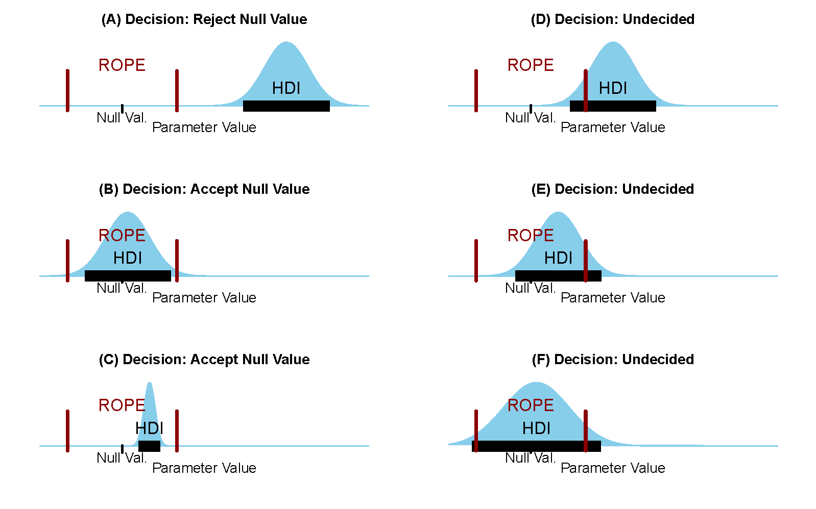
Reminder- ROPE and HDI Test
The ROPE is not a mathematical default. It is a domain-based choice.
Decision logic:
HDI completely outside ROPE → reject the practical null.
HDI completely inside ROPE → accept the practical null.
HDI partly overlaps ROPE → no clear decision.

Slide 50
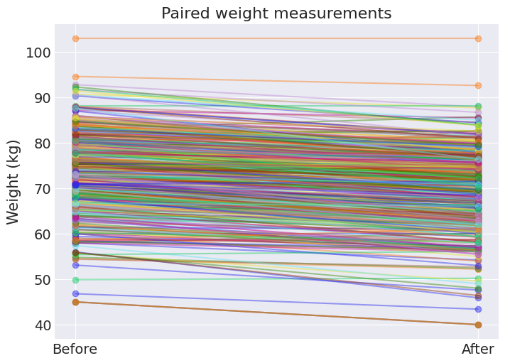
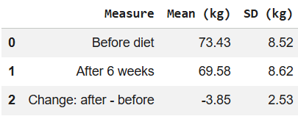
Bayesian Paired Model
Visualize the paired data:

Slide 51
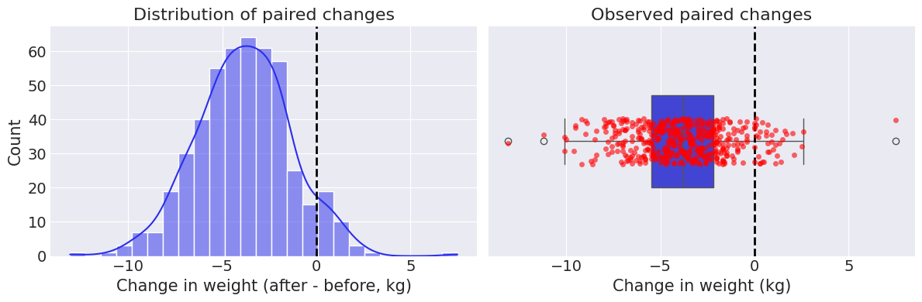
Bayesian Paired Model

Slide 52

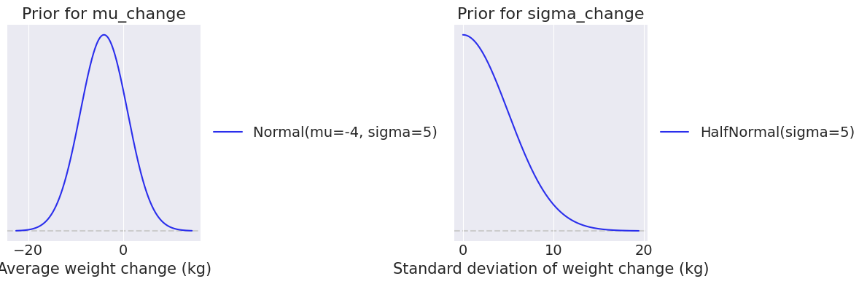
Bayesian Paired Model
Choosing priors for the change
Notes:
Looked reasonable to me

Slide 53

Bayesian Paired Model
Model

Slide 54

Bayesian Paired Model
Model

Slide 55

Bayesian Paired Model
Prior predictive

Slide 56


Bayesian Paired Model
Diagnostics

Slide 57


Bayesian Paired Model
Posterior Predictive

Slide 58

Bayesian Paired Model
Posterior

Slide 59


Bayesian Paired Model
HDI\ROPE test

Slide 60

Bayesian Paired Model
HDI\ROPE test

Slide 61
Bayesian Paired Model
Reporting
The observed mean change after six weeks was -3.85 kg.
The Bayesian paired Normal model estimated the posterior mean change as -3.85 kg, with a 94% HDI from-4.06 to -3.64 kg.
The posterior probability that the change is positive was 0.000.

Slide 62
Frequentist t-tests
Frequentist t-tests are used to test hypotheses about means of continuous variables.
They compare an observed mean difference to the variation expected under the null hypothesis.

Slide 63

Frequentist t-tests
A t-test assumes the null hypothesis is true.
Under $H_{0}$, the test statistic follows a t-distribution:
$$t = \frac{observed estimate − null value}{standard error}$$
The t-distribution is the null sampling distribution of the t-statistic.
We ask:
If H0 were true, how extreme would our observed t-statistic be?
A very extreme t-statistic gives a small p-value.
Notes:
נדבר על התפלגות T בהמשך

Slide 64

Frequentist t-tests
Why do we use the t-distribution?
The z-test uses a Normal reference distribution.
The t-test uses a t-distribution because the population standard deviation is unknown and estimated from the sample.
$$t \sim t_{df}$$
The t-distribution:
Is centered at 0 under $H_{0}$
Has heavier tails than the Normal distribution
Depends on degrees of freedom
Becomes closer to Normal as df increases

Slide 65

Frequentist t-tests
One-sample t-test
Tests whether one mean differs from a reference value.
$$H_{0}:μ=μ_{0}$$
Paired t-test
Tests whether the mean within-subject change differs from zero.
$$H_{0}:μ_{\text{change}} =0$$
Independent two-sample t-test
Tests whether two independent group means differ.
$$H_{0}:μ_{A}−μ_{B}=0$$
Welch t-test
Same mean comparison as the independent t-test, but does not assume equal variances.
Mann–Whitney / Wilcoxon
Rank-based alternatives

Slide 66

t-Test Overview
Test Type | ${Common H}_{0}$ | Description | Example
One-sample t-test | $$H_{0}:μ=μ_{0}$$ | One continuous variable compared to a reference value | Is average reaction time different from 300 ms?
Paired two-sample t-test | $$H_{0}:μ_{\text{change}} =0$$ | Same subjects measured twice, or matched pairs | Pre/post-treatment, left vs. right
Independent two-sample t-test | $$H_{0}:μ_{A}−μ_{B}=0$$ | Two separate groups | Control vs. experimental group
Welch t-test | $$H_{0}:μ_{A}−μ_{B}=0$$ | Two independent groups, unequal variances allowed | Same comparison, but group spreads may differ
Mann–Whitney | Distributions differ between groups | Two independent groups | Rank-based independent-group alternative
Wilcoxon | Median paired change =0 | Paired / repeated measurements | Rank-based paired alternative
Notes:
One-sample t-test
Tests whether one mean differs from a reference value.
$$H_{0}:μ=μ_{0}$$
Paired t-test
Tests whether the mean within-subject change differs from zero. One-sample t-test applied to the within-subject changes
$$H_{0}:μ_{\text{change}} =0$$
Independent two-sample t-test
Tests whether two independent group means differ.
$$H_{0}:μ_{A}−μ_{B}=0$$
Welch t-test
Same mean comparison as the independent t-test, but does not assume equal variances.
Mann–Whitney / Wilcoxon
Rank-based alternatives

Slide 67
t-Test
Assumptions:
The outcome variable is continuous (not categorical)
Data (or paired differences) are approximately normal
Observations are independent (for independent t-test)
Equal variances between groups (or use Welch’s correction)
Notes:
1. "Continuous" means continuous-valued data
This refers to a numeric variable that can take on any real number within a range (e.g., height, weight, reaction time).
t-tests assume the outcome variable is not categorical or discrete (e.g., not group labels or counts).
Example: body_mass in the penguins dataset is continuous.
2. Approximately normally distributed outcome
For independent t-tests: both groups should have outcomes that are approximately normal.
For paired t-tests: the differences between the paired observations (e.g., after - before) should be normally distributed.
3. Independent observations
For independent t-tests, each observation must be from a different, unrelated individual or subject.
Observations within and between groups must not be correlated.
4. Equal variances (homogeneity of variance)
Standard t-tests assume both groups have similar variance (spread).
If this isn’t true, we use the Welch correction (i.e., equal_var=False in ttest_ind), which relaxes this assumption:
from scipy import stats
stats.ttest_ind(group1, group2, equal_var=False) # Welch’s t-test

Slide 68
Paired t-Test
foodDiet_extended.csv dataset:
Same participants measured before and after diet
Tests whether mean weight changed significantly after the diet

Slide 69

Paired t-Test
The paired t-test asks whether the average within-subject change is different from zero.
For each subject:
$${\text{change}}_{i}={\text{after}}_{i}{\text{− }\text{before}}_{i}$$
Null hypothesis:
$$H_{0}:μ_{change} =0$$
In paired t-test :
$$t \sim t_{df}, df=n−1$$
Test statistic:
$$t=\frac{{\overline{x}}_{change} −0}{\frac{s_{change}}{\sqrt{n}}}$$
where:
${\overline{x}}_{change}$𝑖𝑠 𝑡ℎ𝑒 𝑎𝑣𝑒𝑟𝑎𝑔𝑒 𝑜𝑏𝑠𝑒𝑟𝑣𝑒𝑑 𝑐ℎ𝑎𝑛𝑔𝑒
$s_{change }$𝑖𝑠 𝑡ℎ𝑒 𝑠𝑡𝑎𝑛𝑑𝑎𝑟𝑑 𝑑𝑒𝑣𝑖𝑎𝑡𝑖𝑜𝑛 𝑜𝑓 𝑡ℎ𝑒 𝑐ℎ𝑎𝑛𝑔𝑒𝑠
𝑛 𝑖𝑠 𝑡ℎ𝑒 𝑛𝑢𝑚𝑏𝑒𝑟 𝑜𝑓 𝑝𝑎𝑖𝑟𝑒𝑑 𝑜𝑏𝑠𝑒𝑟𝑣𝑎𝑡𝑖𝑜𝑛𝑠
Decision:
$$p<α⇒\text{Reject} H_{0}$$
Notes:
$$t\sim t_{df}$$
$$df=n−1$$ Degrees of freedom determine the shape of the $t$-distribution. With fewer degrees of freedom, the $t$-distribution has heavier tails because the standard deviation is estimated with more uncertainty.

Slide 70


Paired t-Test
https://docs.scipy.org/doc/scipy/reference/generated/scipy.stats.ttest_rel.html

Slide 71


Paired t-Test
t-statistic: -33.319
p-Value : $7.976∙{10}^{−127} \left(< 0.05\right)⇒\text{low} \text{value}\text{, }\text{indicating} \text{strong} \text{statistical} \text{significance}$
CI:[-4.078, -3.624]
$C$ohen’s d: -1.521 (large effect size)
-> Weight was significantly lower after the diet.

Slide 72

Paired t-Test

Slide 73
Paired t-Test
Reporting –
The observed mean change after six weeks was -3.85 kg (after - before), with a 95% confidence interval from -4.08 to -3.62 kg.
The frequentist paired t-test gave t(479) = -33.32 and p = 7.976e-127. Therefore, using alpha = 0.05, we reject H0.

Slide 74

Paired Wilcoxon-Test
Rank-based test
It is used for paired data when we do not want to rely as strongly on the Normal model for the change scores. It tests whether the paired differences are systematically above or below zero.
Notes:
The Wilcoxon test is not the same model as the paired t-test. It is rank-based, so it answers a related but not identical question.

Slide 75


Student’s t-distribution
Similar to Normal distribution but with thicker tails
Has a parameter $ν$, which is the normality parameter (or degrees of freedom)
Converges to normal distribution as 𝜈→∞

Slide 76

Student’s t-distribution
The thicker tails allows for capturing the outliers without necessitating an increase in the variance.
Higher $ν$ can mean higher $σ$ because the student’s t distribution will be more like a normal distribution and capture the outlier information less well.
Repeat our analysis with the student’s t distribution

Slide 77


Student’s t-distribution
The thicker tails allows for capturing the outliers without necessitating an increase in the variance.
The parameter $ν$controls tail thickness:
smaller $ν :$heavier tails
larger $ν$: closer to Normal

Slide 78


Student’s t-distribution
The parameter $ν$controls tail thickness:
smaller $ν :$heavier tails
larger $ν$: closer to Normal

Slide 79

Robust Model
Model
Notes:
The deterministic-variable trick helps when we want to define a new parameter that depends on another parameter while enforcing a mathematical constraint.
In the Student-t model, the parameter
$$ν$$
controls the tail thickness. But $ν$must be positive, and usually we want it to be larger than 1.
Instead of sampling $ν$directly, we define:
$$ν_{\text{minus} \text{one}}∼\text{Exponential}$$
and then:
$$ν=ν_{\text{minus} \text{one}}+1$$
Because the Exponential distribution only produces positive values,
$$ν_{\text{minus} \text{one}}>0$$
adding 1 guarantees that:
$$ν>1$$
So this trick lets us enforce the constraint on $ν$while still keeping the model easy to sample and interpret. The model samples $ν_{\text{minus} \text{one}}$, and pm.Deterministic saves the transformed value $ν$in the posterior._

Slide 80

Robust Model
Model

Slide 81

Robust Model
Prior Predictive

Slide 82


Robust Model
Diagnostics

Slide 83

Robust Model
Posterior Predictive

Slide 84
Robust Model
Compare Normal and Student-t posterior predictive

Slide 85

Robust Model
Compare Normal and Student-t posteriors

Slide 86

Robust Model
Compare Normal and Student-t posteriors

Slide 87

Unequal variances
Shared $σ$ model
$$y_{i}∼\text{Normal}\left(μ_{\text{group}\left[i\right]} , σ\right)$$
Assumes:
$$σ_{A}=σ_{B}$$
Separate $σ$ model
$$y_{i}∼\text{Normal}\left(μ_{\text{group}\left[i\right]} , σ_{\text{group}\left[i\right]}\right)$$
Allows:
$$σ_{A}≠σ_{B}$$

Slide 88
Bayesian group model
The same food diet dataset is used for the independent group comparison.
We will compare pre-diet weight between male and female participants.
This is an unpaired comparison because different people belong to each group.

Slide 89


Bayesian group model
Observed data

Slide 90
Bayesian group model
Violin plot:
Shows the distribution of the data in each group.
The width represents where more observations are concentrated.
A wider area means that more participants had weights around that value.
Helps us see both the center and the spread of each group, not only the average.
Notes:
This plot is violin plot + box plot + strip plot for the individual participants (orange dots)

Slide 91

Bayesian group model with shared sigma
Model

Slide 92

Bayesian group model with shared sigma
Model

Slide 93

Bayesian group model with shared sigma
Prior predictive

Slide 94


Bayesian group model with shared sigma
Diagnostics

Slide 95

Bayesian group model with shared sigma
Posterior predictive

Slide 96


Bayesian group model with shared sigma
Posterior effect size

Slide 97


Bayesian group model with shared sigma
Posterior

Slide 98

Bayesian group model with shared sigma
ROPE\HDI test

Slide 99
Bayesian group model with separate sigma
What if the different groups had different sigma’s?

Slide 100

Bayesian group model with separate sigma
Model

Slide 101

Bayesian group model with separate sigma
Model

Slide 102
Bayesian group model with separate sigma
Model grouped sigma separate sigma

Slide 103

Bayesian group model with shared sigma
Posterior predictive grouped sigma separate sigma

Slide 104

Bayesian group model with shared sigma
Posterior predictive
grouped sigma separate sigma
Notes:
The separate-sigma model does not assume that both gender groups have the same spread. When the posterior predictive distribution is plotted for all observations together, it combines two group-specific Normal distributions. This mixture can look skewed even though each group is modeled with a Normal likelihood.

Slide 105

Bayesian group model with shared sigma
In this dataset, the posterior mean difference is almost identical in both models.
The conclusion that males have higher weight is not sensitive to whether we assume equal or unequal variances.

Slide 106


Bayesian group model with shared sigma
Posterior
The separate $σ$model adds information about variability.
The posterior estimate of $σ_{male} −σ_{female}$is negative, and the sigma ratio is under 1 (-0.67), suggesting that females weight may be more variable.
This affects the spread interpretation, but not the main mean-difference conclusion.

Slide 107

Bayesian group model with shared sigma
Posterior comparison

Slide 108

t-Test Overview
Test Type | ${Common H}_{0}$ | Description | Example
One-sample t-test | $$H_{0}:μ=μ_{0}$$ | One continuous variable compared to a reference value | Is average reaction time different from 300 ms?
Paired two-sample t-test | $$H_{0}:μ_{\text{change}} =0$$ | Same subjects measured twice, or matched pairs | Pre/post-treatment, left vs. right
Independent two-sample t-test | $$H_{0}:μ_{A}−μ_{B}=0$$ | Two separate groups | Control vs. experimental group
Welch t-test | $$H_{0}:μ_{A}−μ_{B}=0$$ | Two independent groups, unequal variances allowed | Same comparison, but group spreads may differ
Mann–Whitney | Distributions differ between groups | Two independent groups | Rank-based independent-group alternative
Wilcoxon | Median paired change =0 | Paired / repeated measurements | Rank-based paired alternative

Slide 109
Independent t-Test
Observed data

Slide 110

Independent t-Test
In independent t-test we assume independent measurements.
Here, we compare pre-diet weight between males and females:
$$H_{0}:μ_{\text{male}}−μ_{\text{female}}=0$$
$$H_{1}:μ_{\text{male}}−μ_{\text{female}}≠0$$

Slide 111

Independent t-Test
The test statistic is:
$$t=\frac{{\overline{x}}_{male}−{\overline{x}}_{female}}{s_{p}\sqrt{\frac{1}{n_{male}}+\frac{1}{n_{female}}}}$$
Where:
${\overline{x}}_{male}, {\overline{x}}_{female}$are the sample means,
$n_{\text{male}},n_{\text{female}}$ are the sample sizes,
$s_{\text{male}},s_{\text{female}}$ are the sample standard deviations,
$s_{p}$is the pooled standard deviation
$$s_{p}=\sqrt{\frac{\left(n_{male}−1\right)s_{male}^{2}+\left(n_{female}−1\right)s_{female}^{2}}{n_{male}+n_{female}−2}}$$
Under the null hypothesis:
$$t∼t_{n_{male}+n_{female}−2}$$
If the p-value is smaller than $α$, we reject $H_{0}$
Notes:
$$t\sim t_{df} \\ df=n_{1} + n_{2} −2$$
Degrees of freedom determine the shape of the $t$-distribution. With fewer degrees of freedom, the $t$-distribution has heavier tails because the standard deviation is estimated with more uncertainty.

Slide 112


Independent t-Test

Slide 113

Independent t-Test
t-statistic: 19.085
p-Value : $8.826∙{10}^{−61} \left(< 0.05\right)⇒\text{low} \text{value}\text{, }\text{indicating} \text{strong} \text{statistical} \text{significance}$
CI:[10.04, 12.34]
$C$ohen’s d: 1.742 (large effect size)

Slide 114
Independent t-Test
Reporting
Males had higher pre-diet weight than females. The difference was statistically significant, t(478)= 19.085, p<0.001. The estimated mean difference was 11.197 kg, with a 95% confidence interval of [10.04, 12.34]. The standardized effect size was large, cohen’s d= 1.742.
Notes:
The confidence interval does not include 0, which is consistent with rejecting the null hypothesis. The p-value is very small, meaning that such a large t-statistic would be very unlikely under the null hypothesis of no mean difference.

Slide 115


Independent t-Test
Welch t-test
Used for the same comparison as the independent two-sample t-test:
$$H0 ​:μ_{A} ​−μ_{B} ​=0$$
but it does not assume equal variances between the two groups. :
$$σ_{A}^{2} ​≠σ_{B}^{2} ​$$

Slide 116
Tutorial 6: Main ideas
Continuous data require continuous likelihoods.
The Normal model describes data using center (μ) and spread (σ)
Addition to the Bayesian workflow:
Bayesian p-values as model-fit checks
Paired data:
Analyze within-subject change scores.
Group data:
Use group-specific means, and decide whether σ should be shared or group-specific.
Student-t likelihood:
A robust alternative when data have heavy tails or outliers.
Frequentist t-tests:
Answer questions through null sampling distributions and p-values rather than posterior uncertainty.

